Slide 1
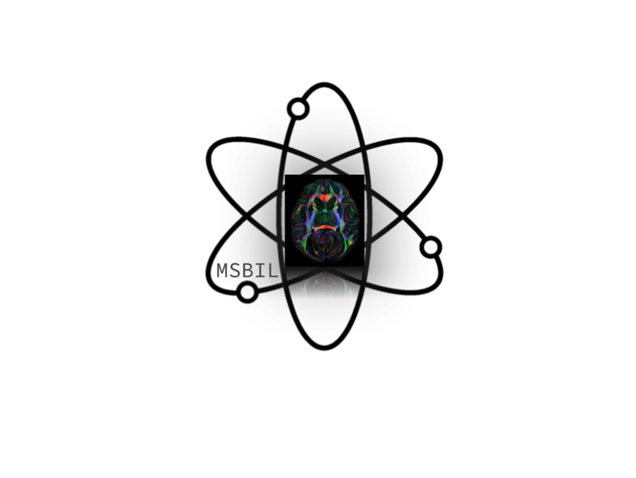



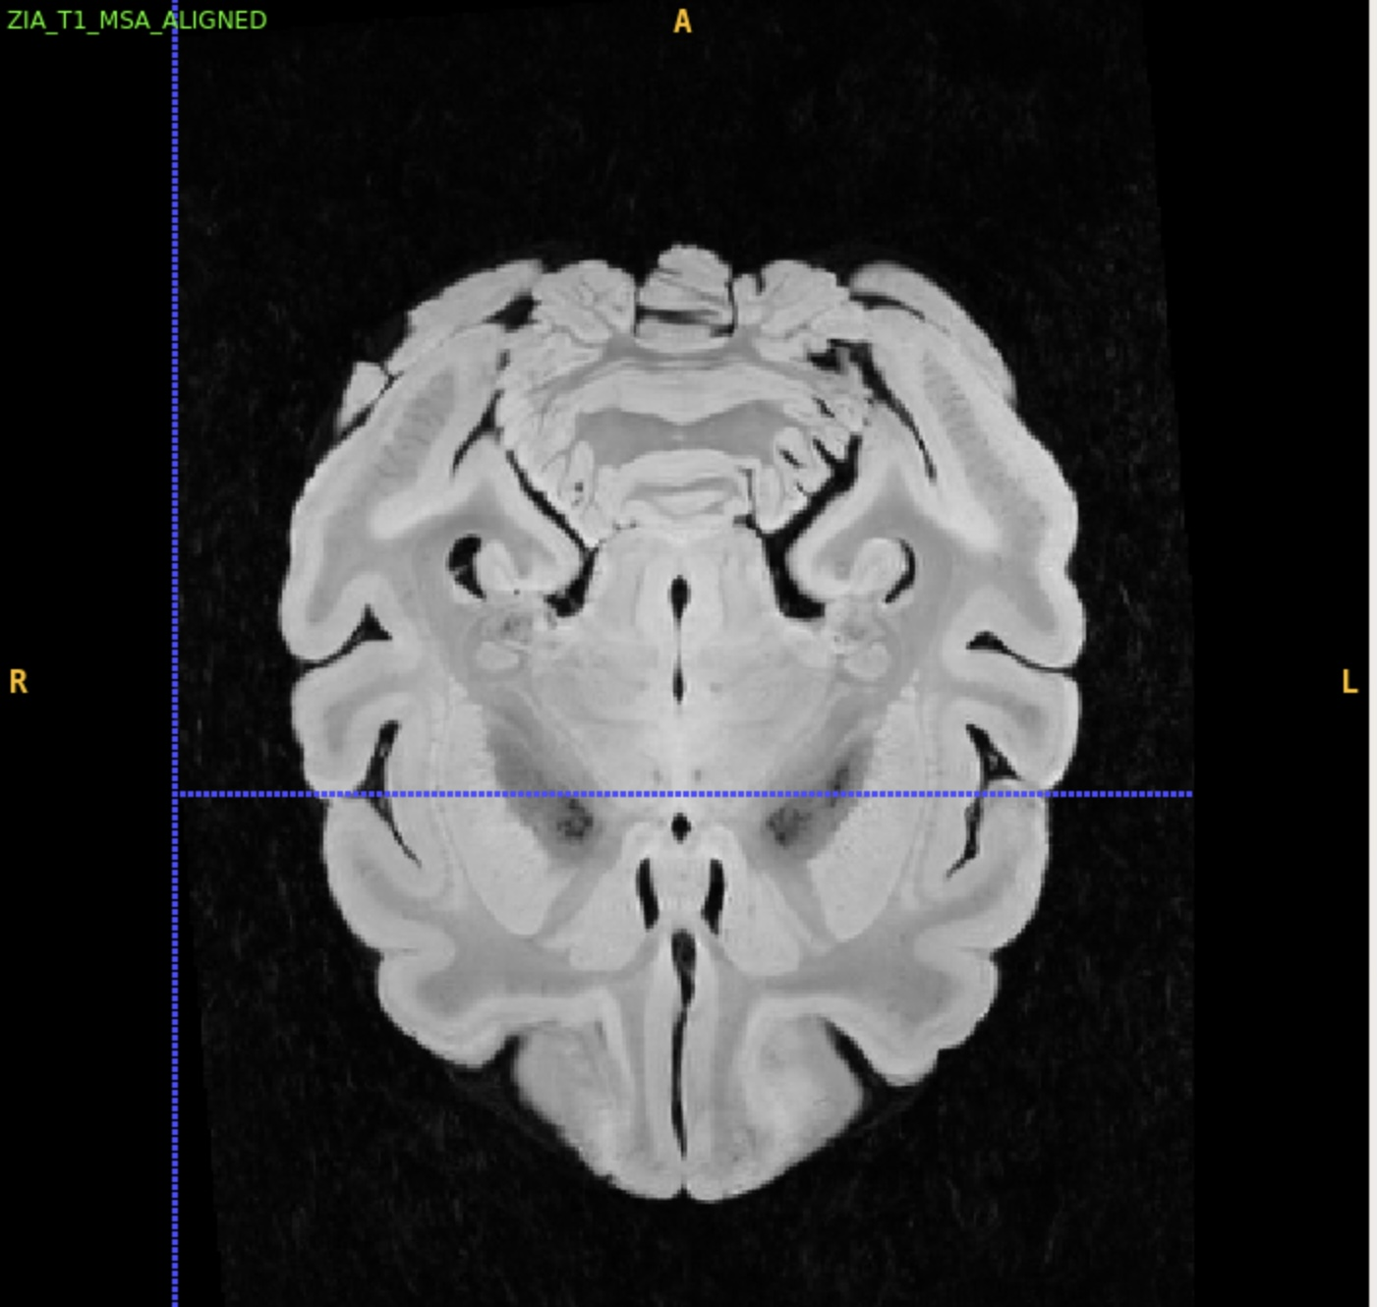
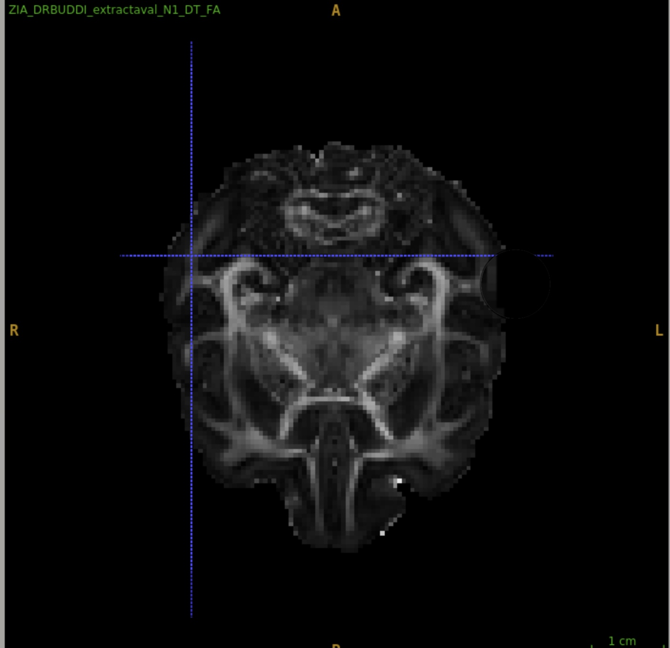
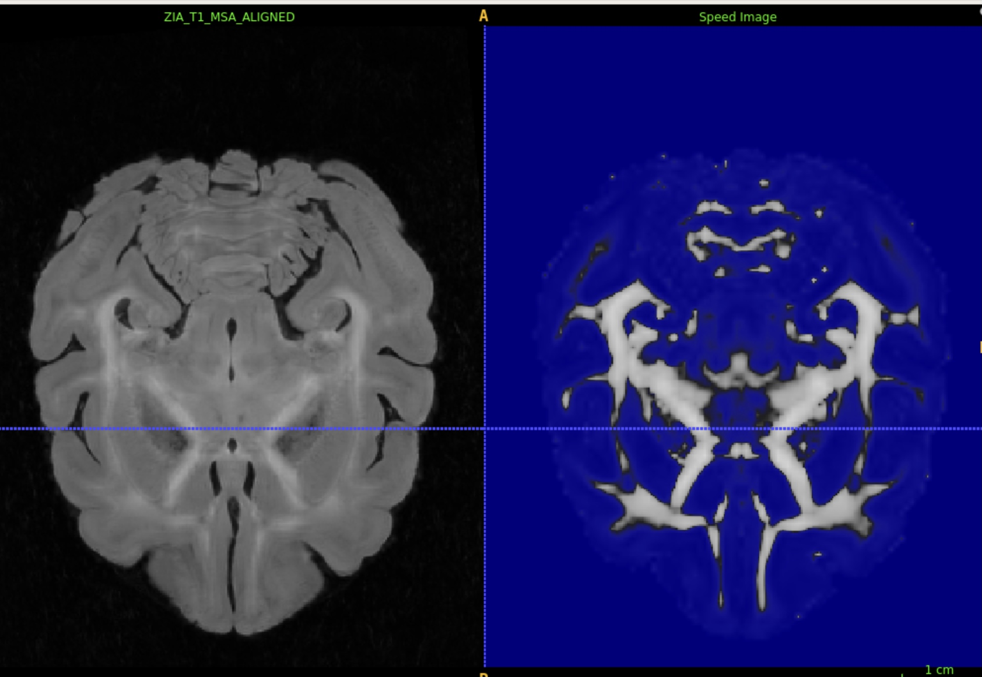
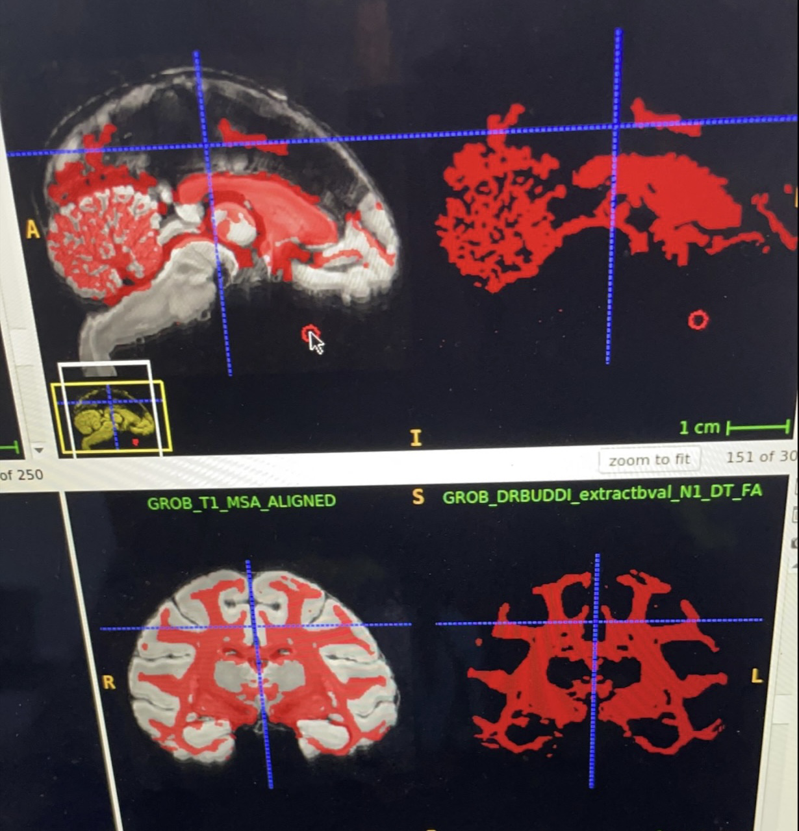
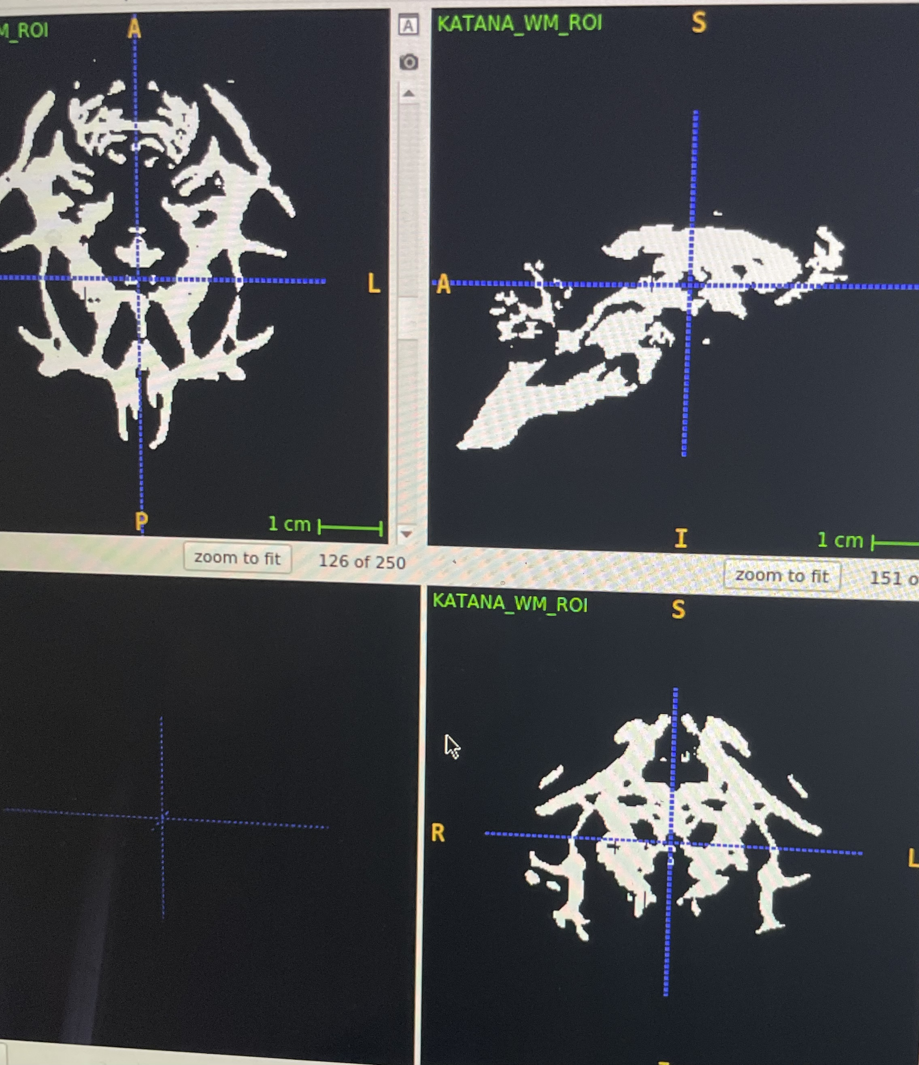
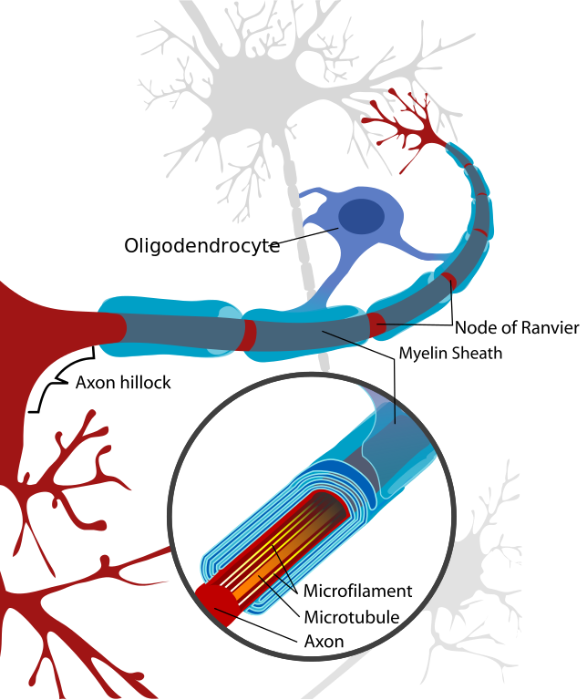
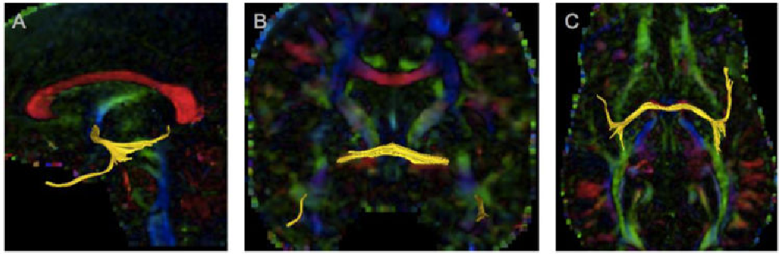
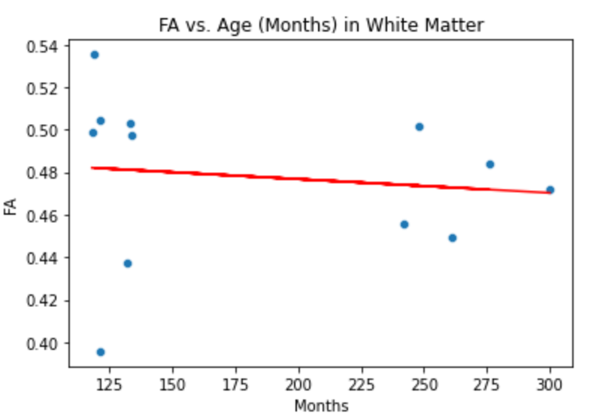
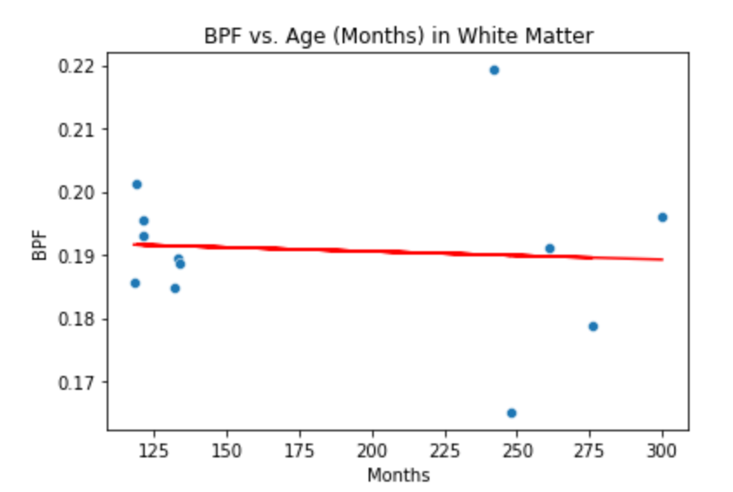
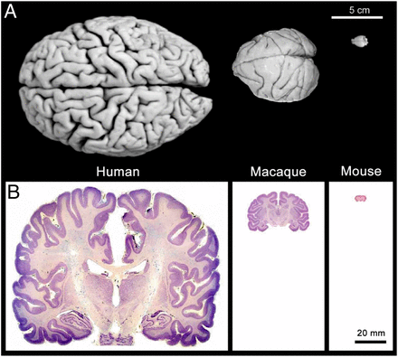
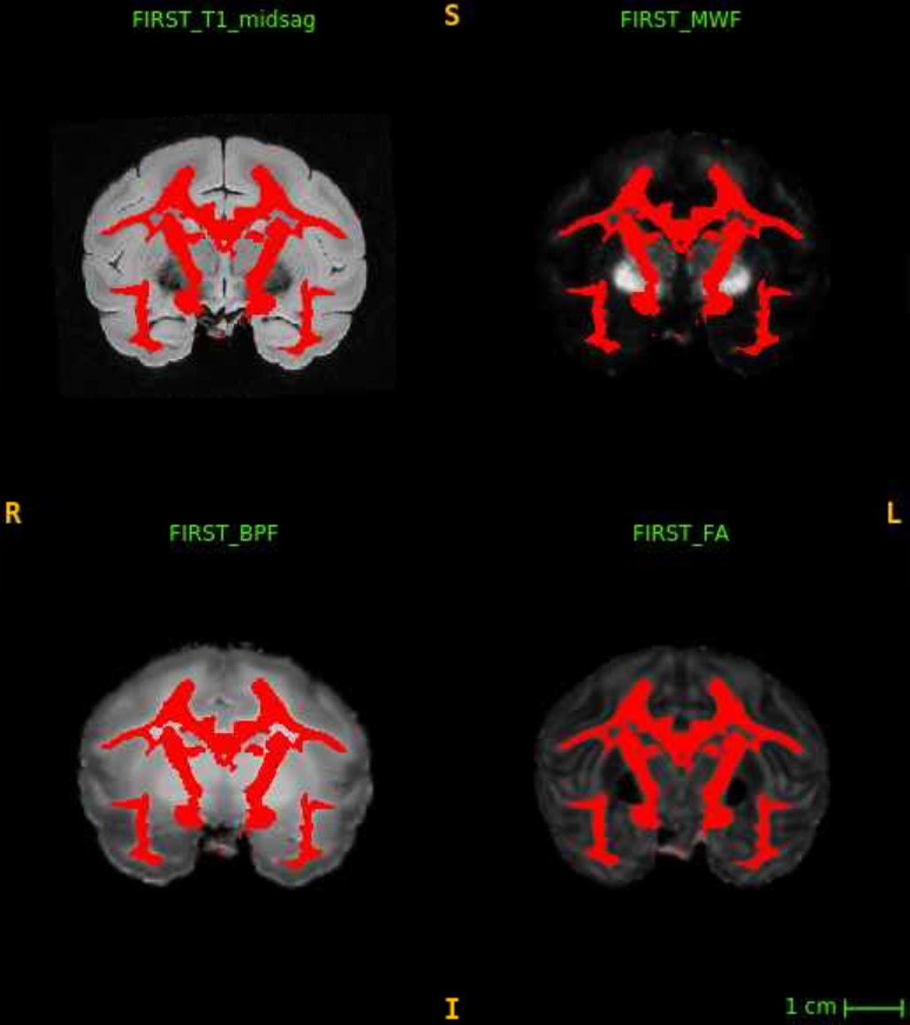
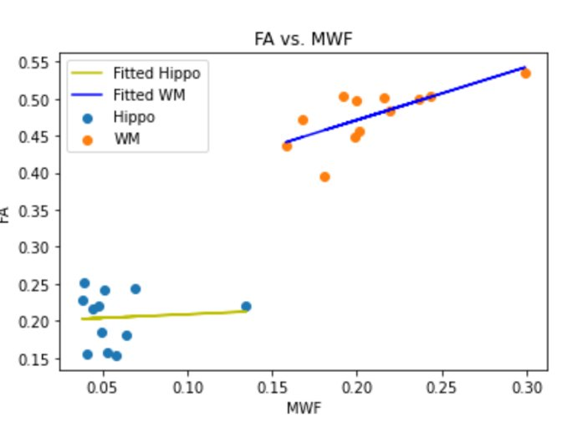
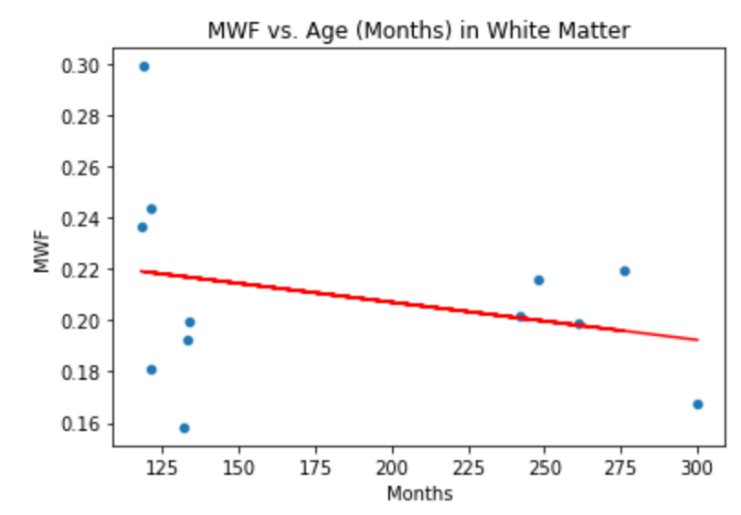

Scrutinizing the effects of normal aging on Bonnet Macaque’s white matter
Eric Foiryolo¹, Laurel Dieckhaus², Elizabeth Hutchinson², Avinash Murlikrishnan¹
¹KEYS Intern, ²University of Arizona Biomedical Engineering Department
Abstract
Materials and Methods
Discussions/Conclusion
“
To
To attain a better understanding of the development of dementia, we evaluated the structural integrity of white matter (WM) in post-mortem Bonnet macaque brains using MRI markers. WM is indicative of communication between brain areas. I developed a protocol to accurately select the WM region for 12 brains. We compared age (months) to multiple MRI markers within the WM regions. Initially, we hypothesized that the MRI maps, Fractional Anisotropy (FA), Bound Pool Fraction (BPF), and Myelin Water Fraction (MWF) would decrease as a result of aging. However, after analysis, no significant correlation between age and MRI metrics that would be indicative of degradation in WM was found. Based on our observations, the structural integrity of white matter appears to remain unchanged with respect to normal aging.
Overlay the T1 and FA map
Threshold the FA map to .3000
Grow the segmentation and finalize masks
Use ROI masks to Extract FA, MWF, AND BPF values from White Matter
The research aimed to scrutinize the impact of normal aging on post-mortem Bonnet Macaques white matter
Initially, we hypothesized that the MRI markers, Fractional Anisotropy (FA), Bound Pool Fraction (BPF), and Myelin Water Fraction (MWF) would decrease as a result of aging.
We found no statistical significance between age and the MRI markers of the white matter that was evaluated.
Possible explanation: evaluated the entire white matter region rather than a single tract.
Our results confirm the result of the previous researchers that evaluated white matter volume throughout normal aging.
Future Directions
Figure 1: Myelinated Axon
The same MRI markers could be used to evaluate the anterior Commissure, a white matter tract that connects the temporal lobes and plays a role in processing speech, hearing, and memory.
Future evaluations of different regions of interest would improve our understanding of the brain’s structure and function across a lifespan, which would aid us in recognizing dementia or other neurodegenerative diseases precisely
Correlative
FA is sensitive to myelin and axon and anything else in the tissue environment.
Analysis
Introduction
Results
To
The best way to understand a neurological disease is by looking at normal neurological functions. Normal aging tells us about normal changes that the brain undergoes.
Objective: evaluate regions of interest in the brain to determine whether the brain’s structure and function are affected by normal aging
Goal evaluate how normal aging impacts white matter in the brain of Bonnet Macaques
Previous research: Provided the rationale for looking at normal aging in human Since primates don’t sporadically develop dementia with respect to normal aging
Fig.6 Anterior Commissure White Matter tract
p value=.696
R value=-0.126
p value=.820
R value=-0.073
Acknowledgement
Figure 5: FA vs Age in White Matter
To
Figure 4: FA vs Age in White Matter
I would like to express my gratitude to
Dr. Hutchinson and the multi-scale brain imaging lab and my lab mentor Laurel Dieckhaus for taking accepting me.
The KEYS program and the staff for an amazing experience and a special thank you to my crew mentor Alexis Cruickshank for being an outstanding crew mentor.
The Barnes Lab and the TBIR-7T.
High Performance Computing (HPC) core
Elena Rodriguez for an impeccable support throughout my KEYS experience.
p value=.0084
R value=0.718
P value=0.368
R value=-0.2.85
References
Figure.2: Human, Macaque, and Mouse brain scale
Figure 3: Different types of MRI markers
Figure 4: FA vs Age in White Matter
Figure 4: FA vs Age in White Matter
Notes:
Billboard Poster 1.5

